Slide 1


Firmware 102

Slide 2
Overview
Installing software
Why not Arduino?
Tips for success
First steps
Taking it further
firmware 102

Slide 3
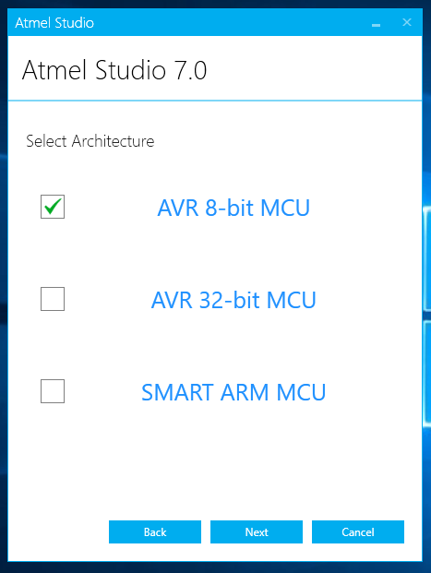
Installing software
Atmel Studio 7 - https://www.microchip.com/avr-support/atmel-studio-7
It’s gonna take a while and need a reboot, so get to it. Expect about 15 minutes.
Install for AVR 8-bit MCU
Stick avrdude.* somewhere simple like C:\
firmware 102

Slide 4
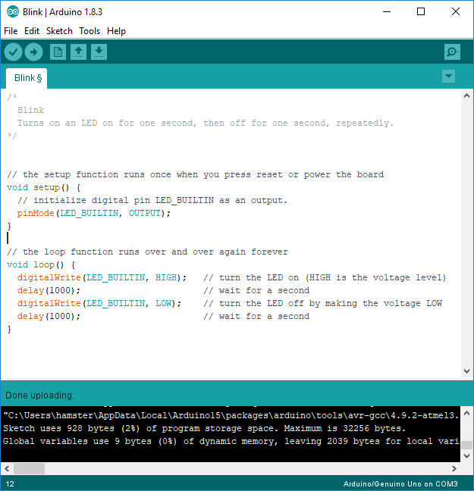
Why not Arduino?
Arduino is a great starting place
It abstracts all the nitty-gritty so it can support lots of MCUs
The IDE is super simple
Don’t need to think about multiple files or file management
firmware 102

Slide 5
Why not Arduino?
Arduino is a great starting place
It abstracts all the nitty-gritty so it can support lots of MCUs
- and as such, you don’t learn about the finer points of your processor
The IDE is super simple
- so simple that you’re going to go mad trying to do much more than ‘hello world’
Don’t need to think about multiple files or file management
- everyone loves a 5000 line source file, right?
firmware 102

Slide 6


So what then?
Notepad?
Atmel Studio?
firmware 102

Slide 7
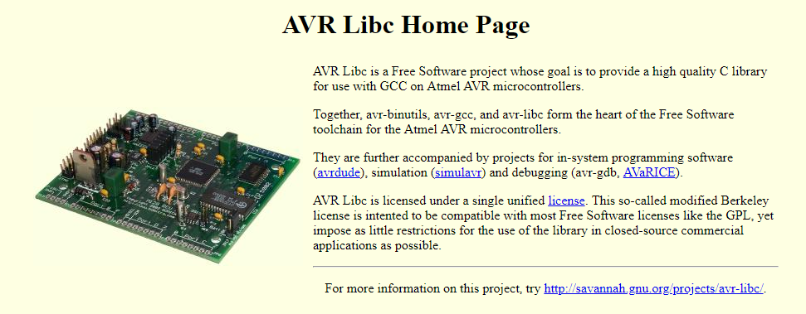
avr-libc
binutils
Utilities for converting assembly code to binary
ld – program linker
as – assembler
objcopy, strip, ar, etc..
Open source binutils and libc for the AVR processors
gcc
The GNU compiler
libc
The standard C library
stdio, stderr
printf, malloc, etc
firmware 102

Slide 8
avr-libc – avrdude
AVRDUDE
AVR Downloader/UploaDEr
Handles programming your AVR
Read/Write flash, fuses, eeprom
Multiple bootloaders/programmers supported
Part of avr-libc
Included with Arduino, but not Atmel Studio
- So I grabbed it for you
firmware 102

Slide 9

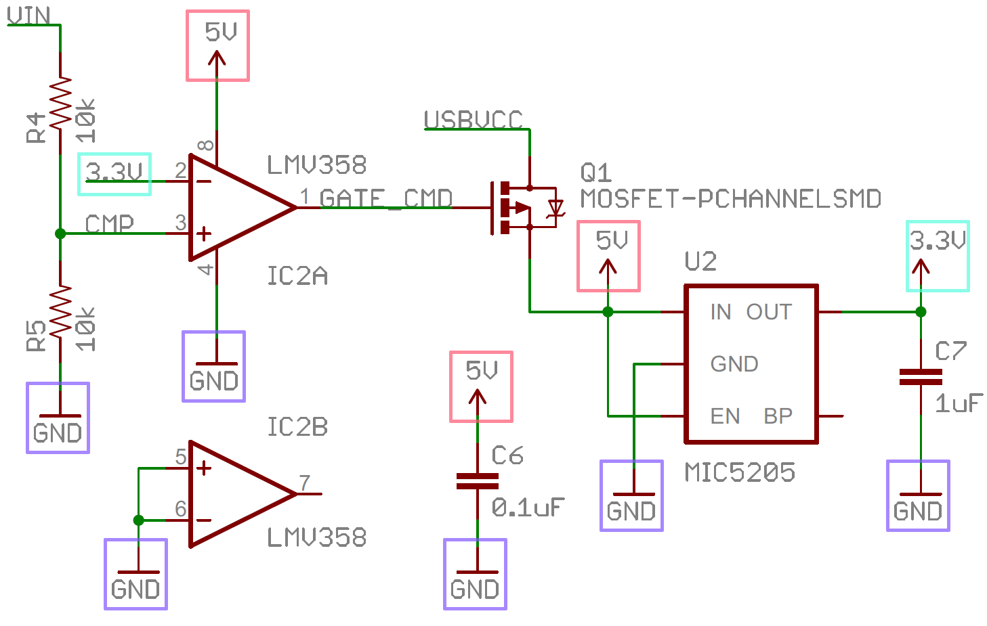
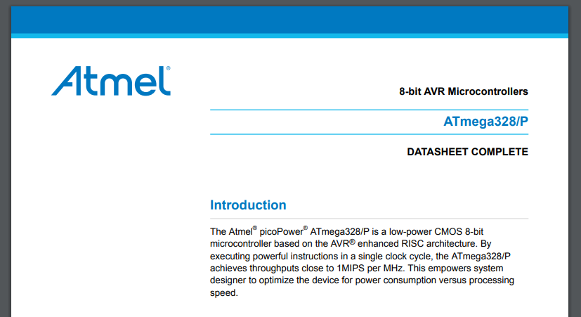

Tips for success
Know your circuit schematic
Keep the datasheet handy
Use comments and verbose code
Code and debug one thing at a time
firmware 102

Slide 10
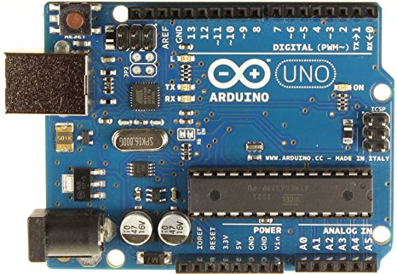
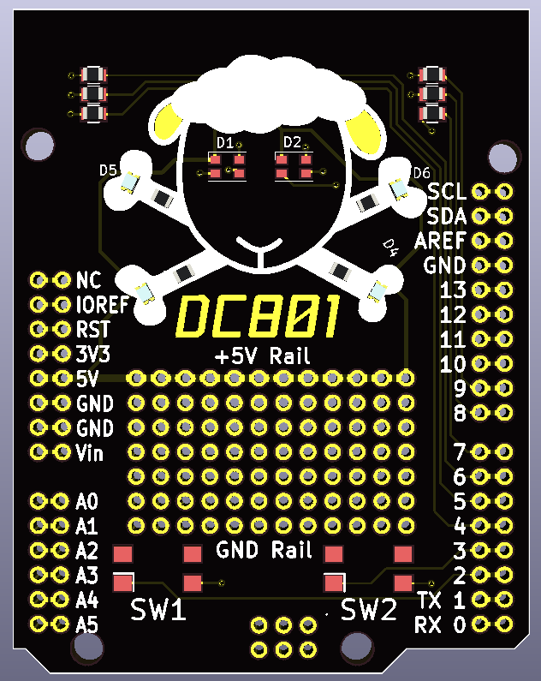
Hardware
firmware 102

Slide 11
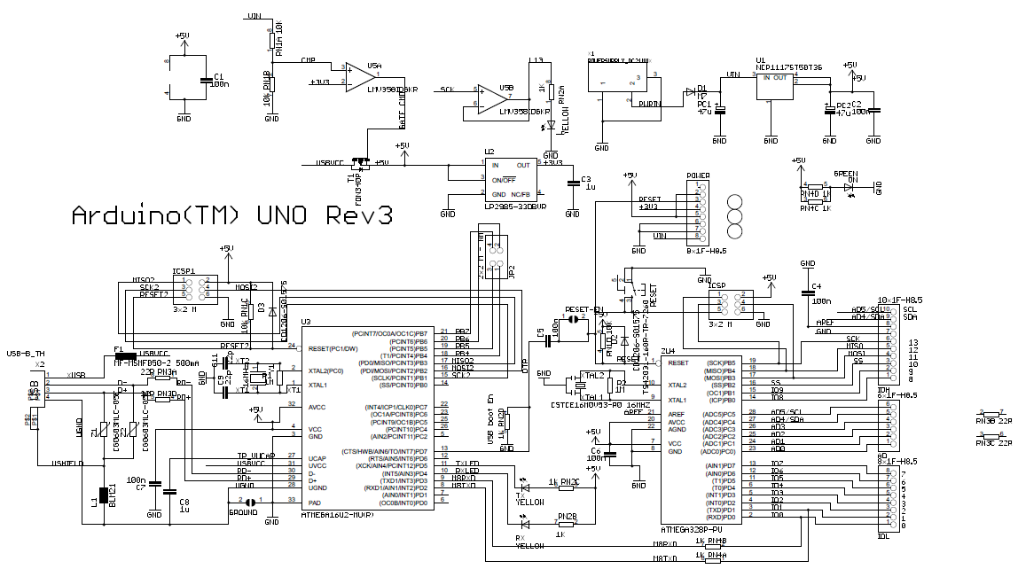
The Schematic – Arduino Uno
firmware 102

Slide 12
The Schematic – Arduino Uno – Break it down
Power Select
Blinker
Power Supply
USB Interface
IO
Clock
MCU
firmware 102

Slide 13
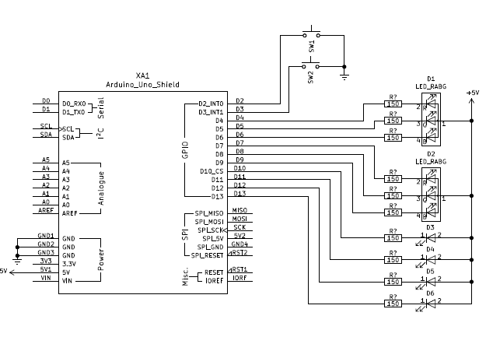
The Schematic – DC801 Shield
firmware 102

Slide 14
The Schematic – DC801 Shield – Break it down
Buttons
Shield IO
Blinkies
firmware 102

Slide 15
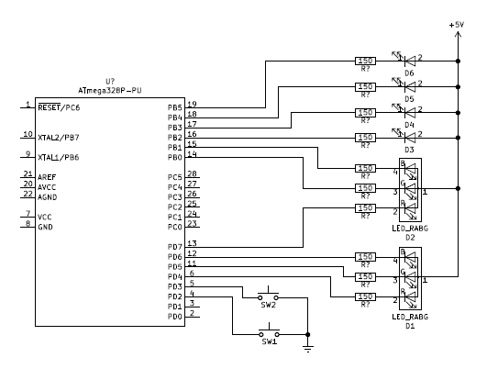
The Schematic - Simplfy it
firmware 102

Slide 16
The Schematic – The imporant bits
Port B
Port D
firmware 102

Slide 17
Setting up your Uno
If Windows doesn’t install the driver for your board, use the drivers I gave you
If you have a fresh Uno, it should blink an LED when you plug it into the USB
For Step 1, leave the shield off
firmware 102

Slide 18
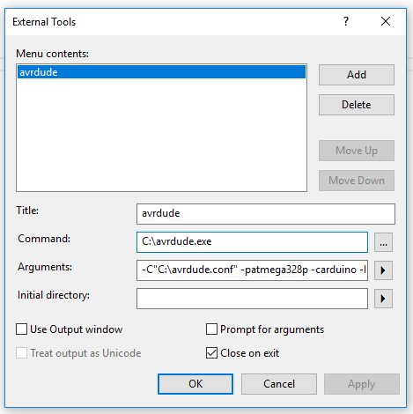
Configuring Atmel Studio
Tools -> External Tools…
Arguments:
-C"C:\avrdude.conf" -patmega328p -carduino
-PCOM3 -b115200 -D
-Uflash:w:"$(ProjectDir)Debug\$(TargetName).hex":i
COM port might be different, check with device manager
firmware 102

Slide 19
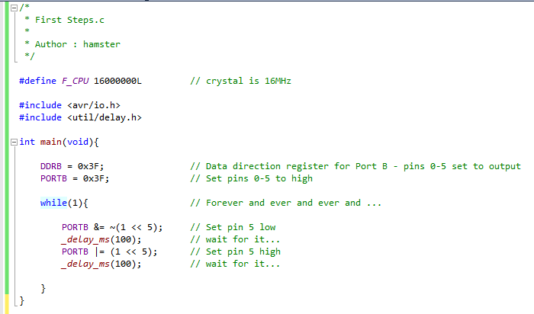
Step 1 – Blink!
Step1 project
firmware 102

Slide 20
Software first steps
Build -> Build Solution (or press F7)
Make sure your Uno is plugged in
Tools -> avrdude
Blink!
firmware 102

Slide 21
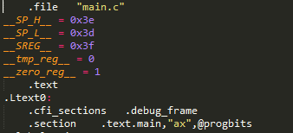


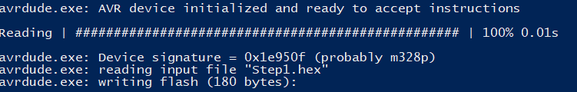
Under the hood
When you hit build
gcc compiles your code into assembly
as converts the assembly into object code
ld links the object code and figures out actual program offsets
objcopy converts the output to a hex file
avrdude flashes the chip
firmware 102

Slide 22
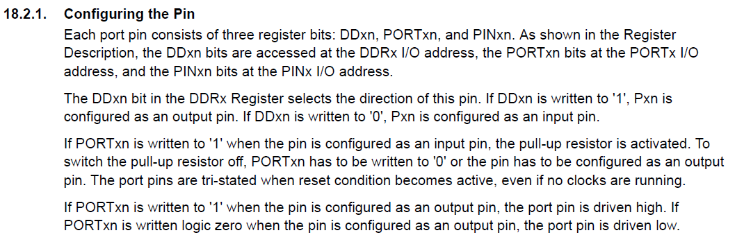
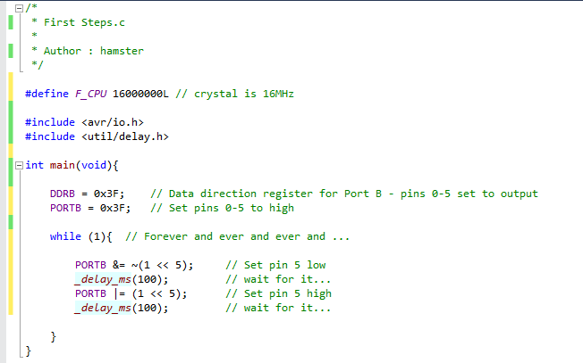
Port B? Data direction registers?
firmware 102

Slide 23
Waiting?
_delay_ms does a busy wait – based on CPU frequency, it executes a bunch of NOPs
firmware 102

Slide 24
Bit shifting??
Set low –
Read the current port pins
(1 << 5) - Shift a 1 5 bits = 0001 0000
~ - bitwise invert it = 1110 1111
Bitwise AND the two – anything not set will be set low
Set the port
Set high –
Read the current port pins
(1 << 5) - Shift a 1 5 bits = 0001 0000
Bitwise OR the two – anything with a 1 will be set high
Set the port
firmware 102

Slide 25
#define is your friend
Pre-processor defines can transform
into
and save your sanity
firmware 102

Slide 26
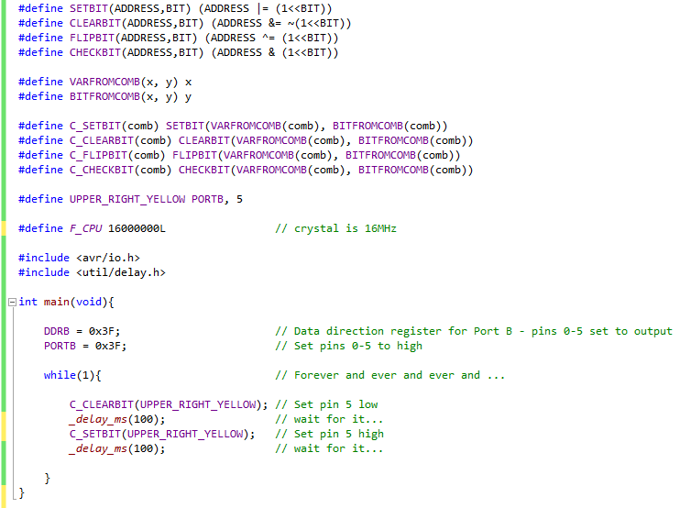
Step 2 – Putting it together
Step2 project
firmware 102

Slide 27
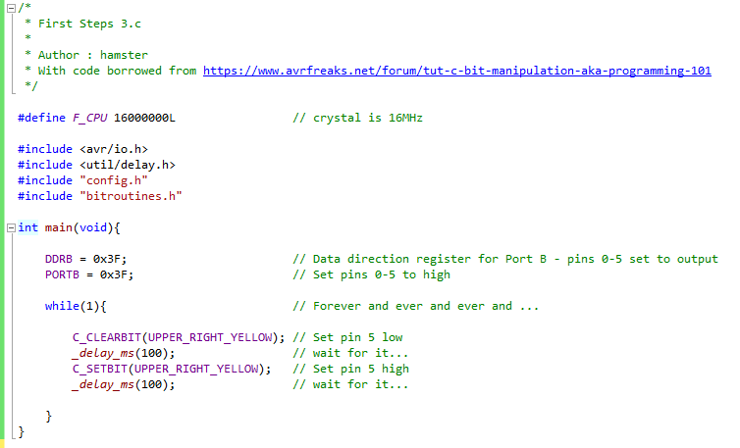
Step 3 – Putting it together – Now with more files
Step3 project
Defines and routines not cluttering up our source!
firmware 102

Slide 28
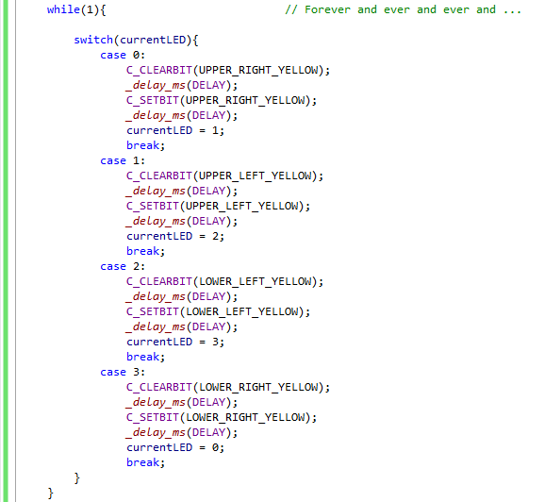
Step 4 – More blinkies
Step4 project
firmware 102

Slide 29
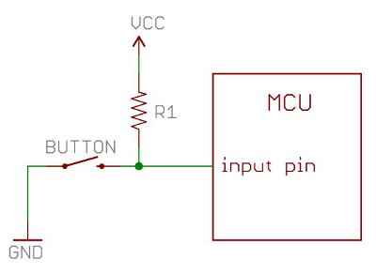
Step 5 – Input – Pullups
To read a pin, it needs to solidly be either low (0V) or high (5v)
A pullup resistor forces the signal to high when the switch is not pressed
Most atmega MCUs can be configured to use an internal pullup
firmware 102

Slide 30
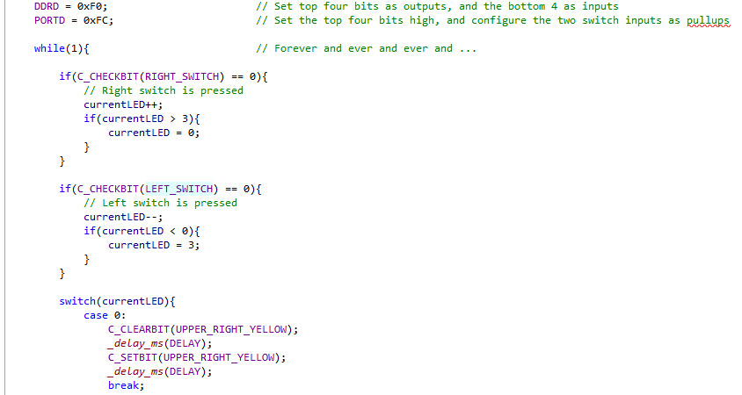
Step 5 – Input
Step5 project
firmware 102

Slide 31
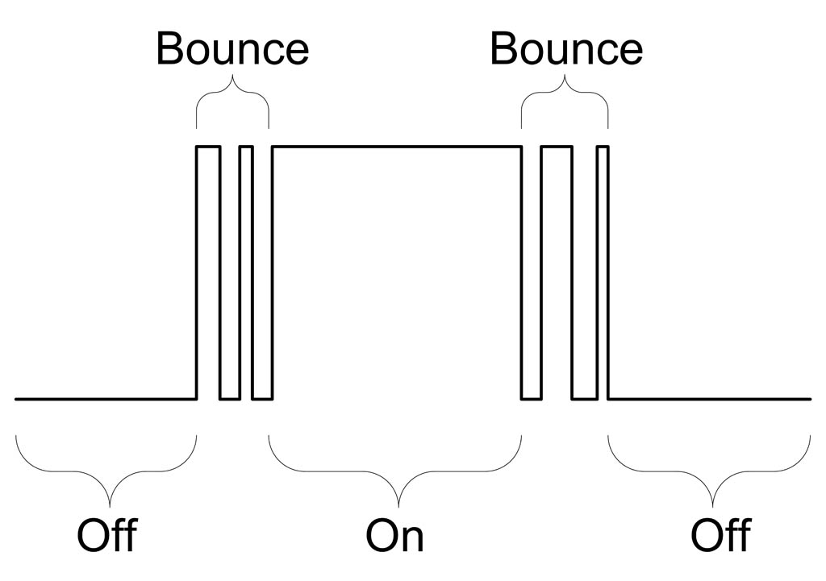
Step 5 – Input – Problems
Some problems with our input example
Button is not read until after the LED is blinked
Button is not debounced
firmware 102

Slide 32
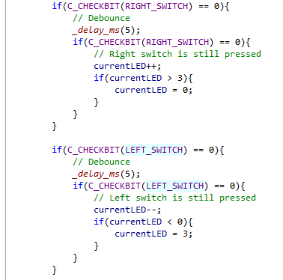
Step 6 – Input – Debounce
Software debounce: read the state, wait, and read again usually covers the bounce
firmware 102

Slide 33
Wrap up
That’s the basics – play with the code, figure out how to make the eyes light up
Next time around we’ll figure out interrupts and PWM
firmware 102

Slide 34
Questions?
Snide Comments?
@hamster
firmware 102

